Slide 2
.NET Roadmap
C. Javier G. Saldana – Developer
@CJavierSaldana

Slide 3
Why do I need a Roadmap?
Notes:
Quiero saber dónde ir
El alcance que puedo tener
Planificar te permite enfocarte en oras cosas
Procura hacerlo con todo con lo que te propones

Slide 4
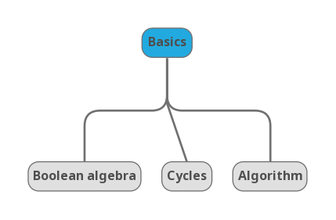

Slide 5
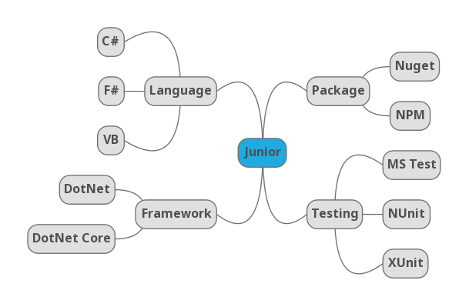

Slide 6
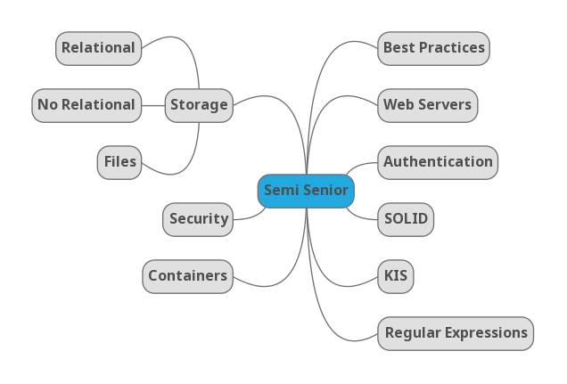

Slide 7
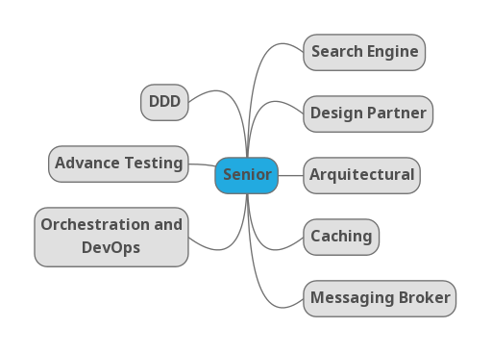

Slide 8


Slide 9


Steeltoe
.NET Core
Microsoft Web Protection Library
MSBuild
DotNetNuke
ASP.NET AJAX Control Toolkit
ASP.NET Core
SourceLink
Microsoft Azure WebJobs SDK
Salesforce Toolkits for .NET
nUnit
MVVM Light Toolkit
IronPython
Mailkit
WorldWide Telescope
Nancy
Open XML SDK
.NET SDK for Hadoop
MvvmCross
MEF
JSON.NET
Mimekit
xUnit
ASP.NET Web Pages
NuGet
IdentityManager
Couchbase Lite for .NET
ML.NET
iOS
macOS
Entity Framework
.NET ECOSYSTEM
WCF
ILMerge
Xamarin.Mobile
ASP.NET SignalR
Infer.NET
.NET Micro Framework
Open Live Writer
Mono
Xamarin.Auth
Xamarin SDK
Orchard CMS
OWIN Authentication Middleware
ProtoBuild
IdentityServer
Microsoft Azure SDK for .NET
.NET Compiler Platform ("Roslyn")
Prism
ASP.NET Web API
Cake
Orleans
Kudu
Cecil
LLILC
Umbraco
System.Drawing
ASP.NET MVC
Notes:
The .NET Foundation is our center of gravity for open development and collaboration around the .NET ecosystem. The .NET Foundation has over 50 projects and hundreds of repos under its stewardship. Open Source Software foundations provide protection, support, services and best practices for helping each project be successful and to grow the ecosystem of people and software.

Slide 10
Thanks

